Slide 1
Kubernetes
The modern way of software deployment

Slide 2
Discussion
How do you plan to host your project on the cloud?
What kind of problems did you faced or think it is important?

Slide 3
What is Kubernetes about?
Container Orchestration
Everything else after you build the container image
Provisioning & Deployment
Load Balancing & Traffic Routing
Autoscaling
…

Slide 4
Install kubectl
https://kubernetes.io/docs/tasks/tools/#kubectl

Slide 5
Provision a GKE cluster on Google Cloud
Try GKE Autopilot!
Grant permission for the cluster to get the service account token
gcloud iam service-accounts add-iam-policy-binding <service-account-email> \ --role roles/iam.workloadIdentityUser \ --member "serviceAccount:<project-id>.svc.id.goog[default/default]"

Slide 6
Main Concepts

Slide 7
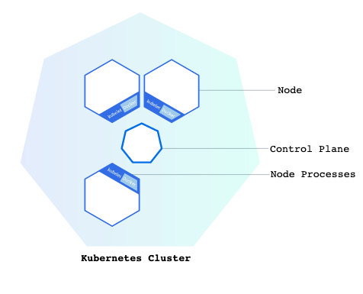
Cluster and node
Communicate with Kubernetes API
(kubectl)

Slide 8
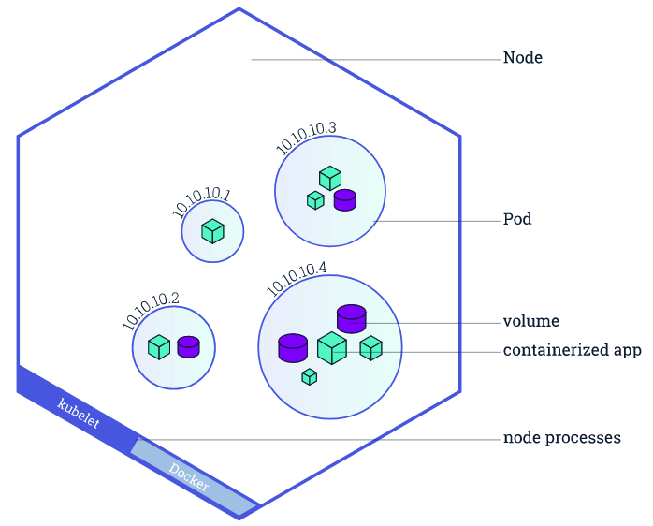
Pod
A Pod is a Kubernetes abstraction that represents a group of one or more application containers and some shared resources for those containers. Those resources include:
Shared storage, as Volumes
Networking, as a unique cluster IP address
Information about how to run each container, such as the container image version or specific ports to use

Slide 9
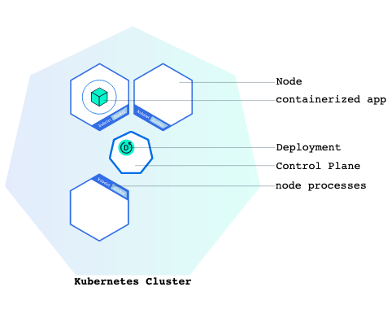
Deployment
A Kubernetes Deployment checks on the health of your Pod and restarts the Pod's Container if it terminates.

Slide 10
Cluster - networking
Pods that are running inside Kubernetes are running on a private, isolated network. By default they are visible from other pods and services within the same kubernetes cluster, but not outside that network.

Slide 11
GCP and kubectl
GCP-specific way to create configuration
gcloud components install gke-gcloud-auth-plugin gcloud components install kubectl # Login gcloud init # Download credentials and config gcloud container clusters get-credentials CLUSTER_NAME --location asia-east-1 # Check the config kubectl config view
kubectl is a client, the corresponding server is the kubernetes control plane.
Note:
Kubectl is developed by Kubernetes, it has no knowledge about GCP.
To connect the client to the server, we need to set some configurations.

Slide 12
kubectl
kubectl version kubectl cluster-info kubectl get [nodes|deployments|pods|services] kubectl describe kubectl logs kubectl exec | kubectl scale kubectl delete
kubectl create deployment hello-node --image=k8s.gcr.io/echoserver:1.4 | kubectl expose deployment hello-node --type=LoadBalancer --port=8080
Cheatsheet: https://kubernetes.io/docs/reference/kubectl/cheatsheet/

Slide 13
Accessing Pods
In normal docker environment, we use port-forwarding.
But in kubernetes, we need to use other ways:
kubectl port-forward (private)
Kubernetes service (public)

Slide 14
Resources in Kubernetes

Slide 15
Resources types
1 | Pod | A bundle of containers, networks and volumes forming an application. A pod can also consist of only a single container.
2 | Deployment | A definition about how pods are managed. You can specify number of replication, auto scaling etc.
3 | Service | An interface to connect from the internet/intranet to pods, networking level. (Equivalent to load balancer (a network hardware)) (Level 4)
4 | Ingress | An interface to connect from the internet to pods, application level. (Equivalent to an Nginx, can perform routing on Path / SSL termination) (Level 7)
5 | Job | Run a single docker image
6 | Cron Job | Run a single docker image rescheduled
7 | Configmap | Key-value pairs, the value can be a large page of config
8 | Secret | Key-value pairs with encryption

Slide 16
Creating a pod
After creation, verify the pod is created with: kubectl get pods
# Command to apply yaml file:
kubectl apply -f xxx.yaml
From command line | From yaml file
kubectl run -i helloworld --image=docker/getting-started | apiVersion: v1 kind: Pod metadata: name: nginx labels: app: nginx-pod spec: containers: - name: nginx image: nginx:1.14.2 ports: - containerPort: 80 - name: getting-started image: docker/getting-started
Note:
1. Format of yaml files is sensitive to indentations

Slide 17
Creating a deployment
From yaml file
apiVersion: apps/v1 kind: Deployment metadata: name: my-nginx labels: app: nginx-dpt spec: replicas: 3 selector: matchLabels: app: nginx-pod template: metadata: labels: app: nginx-pod spec: containers: - name: nginx-c image: nginx:1.14.2 ports: - containerPort: 80
From command line
kubectl create deployment my-nginx --image=nginx:1.14.2 --replicas=3 --port=80
Note:
We must include “template” in the deployment definition, to define how pods will be created later.
After creation, verify the deployment is created with:
kubectl get deployments

Slide 18
Creating a service
From yaml file
apiVersion: v1 kind: Service metadata: name: my-nginx-svc labels: app: nginx-svc spec: type: LoadBalancer ports: - port: 80 selector: app: nginx-pod
From command line
kubectl expose deployment my-nginx --type=LoadBalancer --port=80
Reference:
https://kubernetes.io/docs/concepts/cluster-administration/manage-deployment/

Slide 19
Label
Each pod is tagged with labels.
Labels are key-value pairs.
Check the labels of running pods with:
kubectl get pods --show-labels
kubectl get deployments --show-labels
kubectl get services --show-labels

Slide 20
Label
apiVersion: v1 kind: Service metadata: name: service-name-does-not-matter labels: app: service-label-does-not-matter spec: type: LoadBalancer ports: - port: 80 selector: app: nginx-pod | apiVersion: apps/v1 kind: Deployment metadata: name: dpt-name-does-not-matter labels: app: dpt-label-does-not-matter spec: replicas: 3 selector: matchLabels: app: nginx-pod template: metadata: labels: app: nginx-pod spec: containers: - name: name-does-not-matter image: nginx:1.14.2 ports: - containerPort: 80
The label on pod is used by both Deployment and Service

Slide 21
Service
Service in the context of Kubernetes:
A way to expose a deployment
Types:
ClusterIP: Exposes the Service on a cluster-internal IP. Choosing this value makes the Service only reachable from within the cluster. This is the default ServiceType.
NodePort: Exposes the Service on each Node's IP at a static port (the NodePort). A ClusterIP Service, to which the NodePort Service routes, is automatically created. You'll be able to contact the NodePort Service, from outside the cluster, by requesting <NodeIP>:<NodePort>.
LoadBalancer: Exposes the Service externally using a cloud provider's load balancer. NodePort and ClusterIP Services, to which the external load balancer routes, are automatically created.
ExternalName: Maps the Service to the contents of the externalName field (e.g. foo.bar.example.com), by returning a CNAME record with its value. No proxying of any kind is set up.

Slide 22
Visit a non public service
To visit a ClusterIP service (not public), we can set up a port forwarding through kubectl.
kubectl port-forward "service/hello-world" 8080

Slide 23
Service Selector
Allow services to select its target with labels.
kubectl expose deployment hello-node --type=LoadBalancer --port=8080
The above command implicitly assumed label to be app:hello-node.

Slide 24
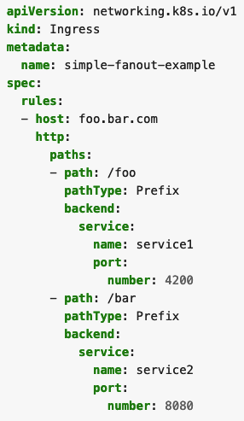
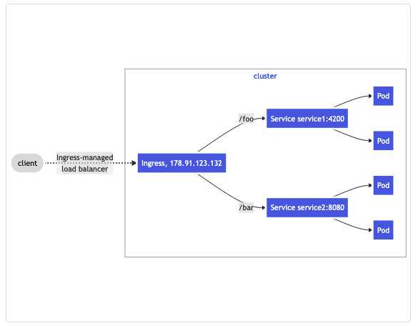
Ingress
https://kubernetes.io/docs/concepts/services-networking/ingress/

Slide 25
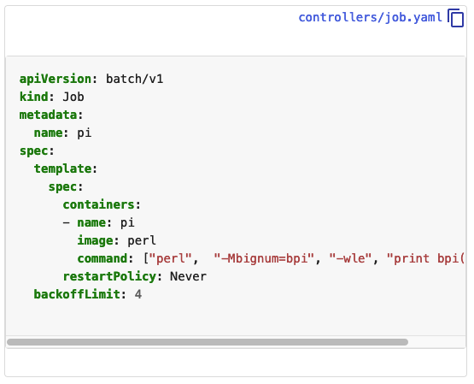
Jobs
https://kubernetes.io/docs/concepts/workloads/controllers/job/

Slide 26
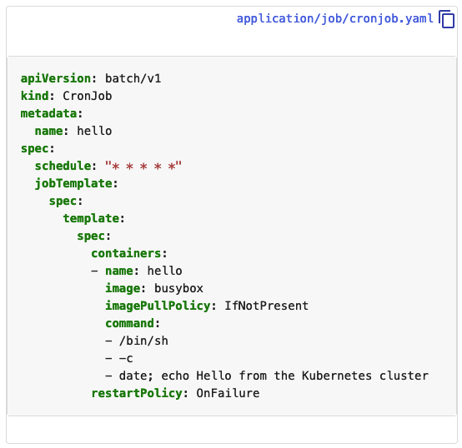
Cron Job
https://kubernetes.io/docs/concepts/workloads/controllers/cron-jobs/

Slide 27
ConfigMap
From yaml file
apiVersion: v1 kind: ConfigMap metadata: name: nginx-conf data: nginx.conf: |- user nginx; worker_processes 1; … …
One can load a config into the config map. Such map can be used later as
Environment variable
Mounted volume

Slide 28
Secret
From yaml file
apiVersion: v1 kind: Secret metadata: name: mariadb-root-password type: Opaque data: password: S3ViZXJuQ==
Secret is more or less the same as configmap.
They are only different when it comes to “who can view the value”.

Slide 29
Accessing a pod

Slide 30
In docker, we use
docker exec -it CONTAINER_NAME bash
In k8s, we use something similar:
kubectl exec --stdin --tty POD_NAME -- bash

Slide 31
Inter-pod linkage

Slide 32

Accessing pods
In the following example:
Both my-nginx-svc and 10.8.8.104 can be reference within k8s internal network.
For internet, we must use 35.193.58.193
Even within the same kubernetes environment, we need a Service to make a pod available to other pods.

Slide 33
Docker/Kubernetes/Containerd

Slide 34
Docker == Container ??
Docker – A developer-oriented software with a high level interface that lets you easily build and run containers from your terminal. It now uses containerd as its container runtime.
Containerd – An abstraction of kernel features that provides a relatively high level container interface. Other software projects can use this to run containers and manage container images.
Kubernetes – A container orchestrator that works with multiple container runtimes, including containerd. Kubernetes is focused on deploying containers in aggregate across one or more physical “nodes.” Historically, Kubernetes was tied to Docker.
Source: https://www.cloudsavvyit.com/10075/what-is-containerd-and-how-does-it-relate-to-docker-and-kubernetes/

Slide 35
Image repository

Slide 36
Image Repository
GCR - Container Registry
docker pull busybox
docker tag busybox gcr.io/my-project/busybox
docker push gcr.io/my-project/busybox
https://cloud.google.com/container-registry/docs/pushing-and-pulling

